Slide 1
INHERITANCE INTERFACES & POLYMORPHISM

Slide 2
Inheritance
Inheritance creates a IS-A relationship.
Derive a new class from an existing one
The existing class is called the parent class or superclass
The derived class is called the child class or subclass.
The child class inherits the methods and data defined in the parent class.
The child can also have its own methods and data.

Slide 3
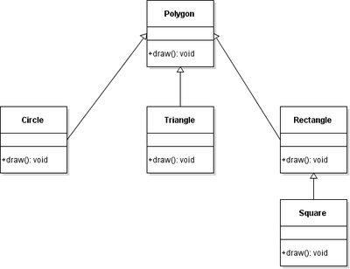

Slide 4
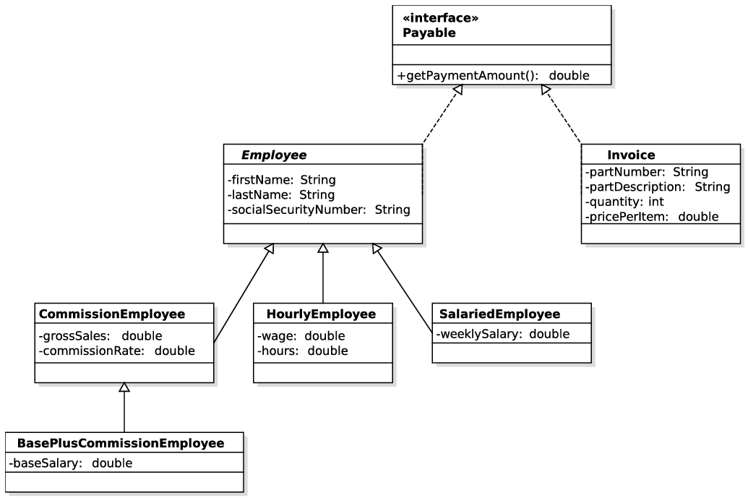

Slide 5
Multiple inheritance
Multiple inheritance allows a class to be derived from two or more classes, inheriting the members of all parents
Collisions, such as the same variable name in two parents, have to be resolved
Java supports only single inheritance, meaning that a derived class can have only one parent class

Slide 6
Data Modifiers
Public : All public variables and methods are visible to sub classes.
Protected : All protected variables are visible to immediate subclasses and all classes in the hierarchy inside the same package.
Private : Private variables are methods are not visible to subclasses.
Other modifiers : static, final

Slide 7
Visibility of methods/variable with modifiers
Modifier | Class | Package | Subclass (Same Package) | Subclass (Different package)
Public | Y | Y | Y | Y
Protected | Y | Y | Y | Y
<no modifier> | Y | Y | Y | N
Private | Y | N | N | N

Slide 8
Super keyword
The super keyword is used to invoke the parent class method / constructor / variables from within the child class.
Super class instructor is automatically called from the child class constructor with/without super() being called from the child constructor.

Slide 9
Polymorphism
Many forms of the same method.
In Java methods ( and constructors) with the same name can have multiple behavior depending upon which class the methods resides in and where it is inherited / implemented from.
Polymorphism is achieved through:
Overriding – same name and signature , but different implementations
Overloading – same name, but different signature and implementations.

Slide 10
Overriding Methods : Polymorphism
Child classes can override method definitions from the parents class.
The new method must have the same signature as the parent's method, but can have a different body
The type of the object executing the method determines which version of the method is invoked
Parent methods with FINAL modifier cannot be overridden.

Slide 11
Overloading Methods: POLYMORPHISM
Overloading deals with multiple methods with the same name but different signature.
Overloading lets you define a similar operation in different ways for different data
Since the method names are same, which method should be invoked is decided at run-time. This is called Dynamic Binding.
Method is invoked depending on the type of data/ number of data used in the method’s signature.

Slide 12
The Object Class
All classes are derived from the Object class defined in the java.lang package of the Java standard class library
If a class is not explicitly defined to be the child of an existing class, it is assumed to be the child of the Object class
Object class is the ultimate root of all class hierarchies
There are two methods we will override from Object Class:
toString()
hashCode()

Slide 13
Interfaces
Interfaces contain method definitions but not implementation.
A class that implements an Interface MUST override and include implementation of all the methods in the interface.
Multiple inheritance is java is achieved through Interfaces
One interface can be derived from another interface
The child interface inherits all methods of the parent
A class implementing the child interface must define all methods from both the ancestor and child interfaces
All members of an interface are public
extends before implements

Slide 14
Abstract Classes
Not to be confused with Interfaces.
Contains abstract or non-abstract methods and be declared with the abstract keyword.
It cannot be instantiated.
It can have constructors.
All abstract methods must be defined with ABSTRACT keyword.
An abstract method contains definition of the method but not its implementation.
The child of an abstract class must override the abstract methods of the parent.
An abstract method cannot be defined as FINAL (because it must be overridden) or STATIC (because it has no definition yet).
The use of abstract classes is a design decision – it helps us establish common elements in a class that is too general to instantiate

Slide 15
JAVA Practice & READING
Explore the “static” and “final” keywords. How do they work with Inheritance and Polymorphed methods/constructors?
Overload a method inside a class with:
Different number of arguments
Different types of arguments
Test all method calls possible for the scenario
Study differences between Abstract Class and Interfaces.
Things to ponder : If Abstract classes cannot be instantiated , what would a constructor of an abstract class do?
Can an Abstract Class inherit other classes / Interfaces? Explore their behavior.
Find other examples of hierarchies from real world objects. What would their class diagram look like?

